Slide 1

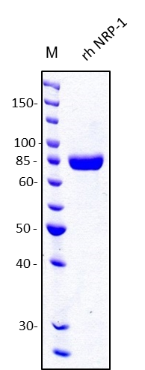
ReliaTech GmbH
Recombinant human Neuropilin-1 (NRP-1)
(Cat #S01-019S / S01-019)
Fig. 1: SDS-PAGE analysis of recombinant human soluble Neuropilin-1 (NRP-1) produced in insect cells. Sample was loaded in 10% SDS-polyacrylamide gel under reducing conditions and stained with Coomassie blue.
http://www.reliatech.de / orders@reliatech.de

